Slide 1
HOTEL RECOMMENDATION SYSTEM

Slide 2
Team Members
B . Vamshi Dhar Reddy
Y . Manju Natha Reddy
Y . Sunil
V . Vamshi Krishna
Y . Bharath Simha Reddy

Slide 3
ABSTRACT
One of the first things to do while planning a trip is to book a good place to stay . Booking a hotel online can be an overwhelming task with thousands of hotels to choose from , for every destination. Motivated by the importance of these situations ,we decided to work on the task of recommending hotels to user . We used Expedia’s hotel recommendation dataset , which has a variety of features that helped us achieve a deep understanding of the process that makes a user choose certain hotels over others . The aim of this hotel recommendation task is to predict and recommend five hotel clusters to a user that he/she is more likely to book given hundred distinct clusters.

Slide 4
MOTIVATION
It helps users to find appropriate hotel rooms at distant places even before visiting . This kind of system reduces travelers problem of accommodation. The best thing about this system is that, it allow users to provide a feedback about their experience with hotel which helps other users and also forces hotel owners for better services to customers.
This system is beneficial to customers and hotels. Customers can find hotels as per their requirements using search function and feedback system. Hotel owners can also benefit from this system as their reach increases to distant parts of the world

Slide 5
OBJECTIVE
The main goal of this project is to create a hotel management framework for use in a hotel . The system should be as adaptable as possible , allowing it to be used in a variety of hotels . To learn about the various techniques that hotels have used . We need to figure out what protocols hotel use , and then build a machine that follow those procedures.

Slide 6
LITERATURE SURVEY
The CF has been explored in many domains of social media (Sun et al., 2014), restaurant (Liu et al., 2013), and travel (Zheng, Burke, & Mobasher, 2012) with the objective of making recommendations to consumers. The similar users or items are identified using a similarity metric (Pappas & Popescu-Belis, 2015) and the evaluation techniques include Pearson Correlation Coefficient, Spearman Rank Correlation Coefficient, Cosine Similarity, and Mean-Square
Difference. A subset of similar users or items will be determined by the most similar neighbours of a target user or item. There are two methods usually used for neighbourhood selection: the similarity thresholding (Gao & Li, 2010) and the top K-nearest neighbor (Sun et al., 2014). The preference prediction researches focus on Recommendation task (Kim et al., 2011) and the Rating prediction task (Sun et al., 2014). In the real world (e.g. social media site or e-commerce site), each individual user has expressed their preferences only on an extremely small portion of the products. Therefore, the system is generally insufficient for identifying similar neighbours for lacking intersection between users or items (Sun et al., 2014). (Hu, Dou, & Liu, 2012) demonstrated that the CARS can explore consumers’ interests and present information on items that match consumers’ preferences based on context information. (Adomavicius & Tuzhilin, 2011) showed there are three recognized paradigms that the contextual information incorporated into RS are contextual pre-filtering, contextual post-filtering, and contextual modeling. In this study, the contextual pre-filtering approach is selected for its straightforward processing and flexibility of justification so the CF can be utilized before or after computing predictions.

Slide 7
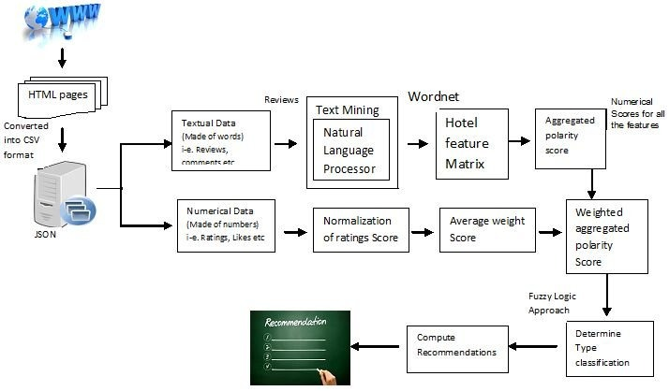
PROPOSED APPROACH
The proposed system recommends hotels based on the hotel features and guest type as additional information for personalized recommendation . The developed system not only has the ability to handle heterogenous data using big data Hadoop platform but it also recommend hotel class based on guest type using fuzzy rules .

Slide 8
The system works in two parallel ways. The numeric ranks and votes of hotels from each selected data source are normalized. On the other hand Review data is processed using Natural language processing package for review mining and features are extracted in the form of a hotel feature matrix. Further, numerical polarity scores are computed for these extracted features using SentiWordNet and average polarity score is calculated. Now weighted average polarity scores are calculated by aggregating normalized rank score, voting score and polarity score. Finally, recommendations are computed by applying the fuzzy logic approach. We have defined a fuzzy set containing certain fuzzy rules to calculate the ﬁnal score to find out the guest type (solo, family, business, friends, couple etc.) for the hotel. The proposed Hotel recommendation approach is shown in Figure The ﬁnal recommendations of the Hotels based on a particular guest type in one of the ﬁve different classes are displayed.

Slide 9
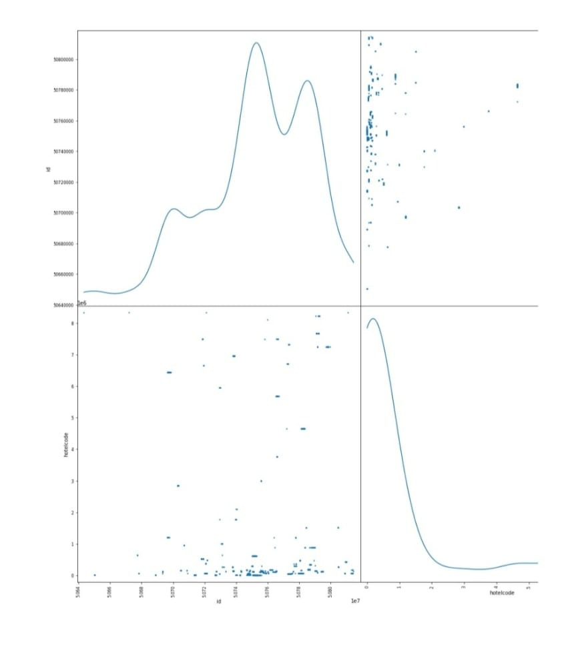
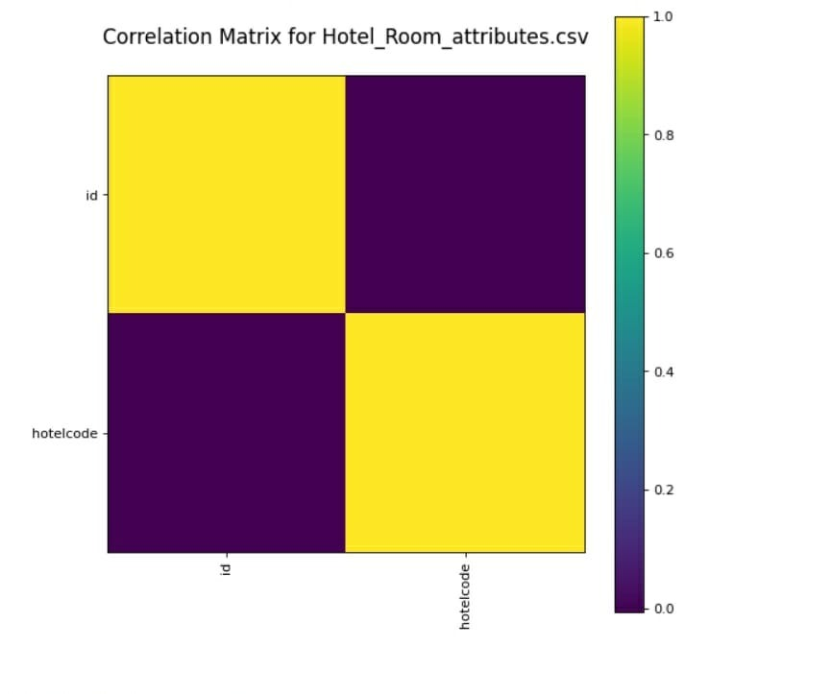
EXPERIMENTATION AND RESULT
In order to evaluate the proposed CAPH framework, we focus on hotels in the USA from TripAdvisor.com. We crawled ratings and reviews from this website based on user’s profile whose review badge is a senior contributor or top contributor (i.e., having written more than 20 reviews). We selected the traveller type as contextual information and assigned it to each rating given the opinion of the consumer reflected on a particular traveller type, which is: Friends and Solo (both have sparsity less than 0.69%). The original dataset contains 279 users, 8257 hotel, and 2092 ratings and reviews.

Slide 10
EXPERIMENTATION
Travel type Friends | Method |  | MAE | RMSE
 | Baseline | UCF ICF | N/A 0.667 | N/A 0.745
 | Our research | CAPH_UCF CAPH_ICF | 0.816 0.436 | 1.040 0.567
Solo | Baseline | UCF ICF | N/A 1.25 | N/A 1.323
 | Our research | CAPH_UCF CAPH_ICF | 0.271 0.235 | 0.297 0.326

Slide 11
Conclusion
We have successfully implemented a hotel recommendation system using Trip Advisor dataset even though most of the data was anonymized which restricted the amount of feature engineering we could do. We ranked the problem at hand as a multi-class classification problem and maximized the probabilities of each cluster, picking the top five clusters at the end. The most important and challenging part of implementing the solutions was to create and extract meaningful features out of the 38 million data points provided to us. After applying multiple models and techniques, we arrived at the conclusion that Ensemble Learning with Data Leak model performs best giving a score of 0.496 on test data. This again reaffirms the fact that combining several weak learners has a synergistic affect. Most of our methods involved ranking of clusters by their predicted class probabilities which seems fair. Due to the volume of data, we could not replicate the distance matrix completion techniques employed by the first rank solution. This leaves a room for future improvement, wherein we can try replicating the existing code in conjunction with our features, data leak solution and ensemble learning to achieve an even better result. Another direction for future work is to try different ranking methods like Rank SVM and Rank Boost which perform well but require a lot of resources.

